Slide 1

Chad Kwong
ckwong@smu.edu
Notes:
This Photo by Unknown Author is licensed under CC BY-SA

Slide 2
Today's Discussion
Our Approach
Discuss Findings
Provide Recommendations

Slide 3
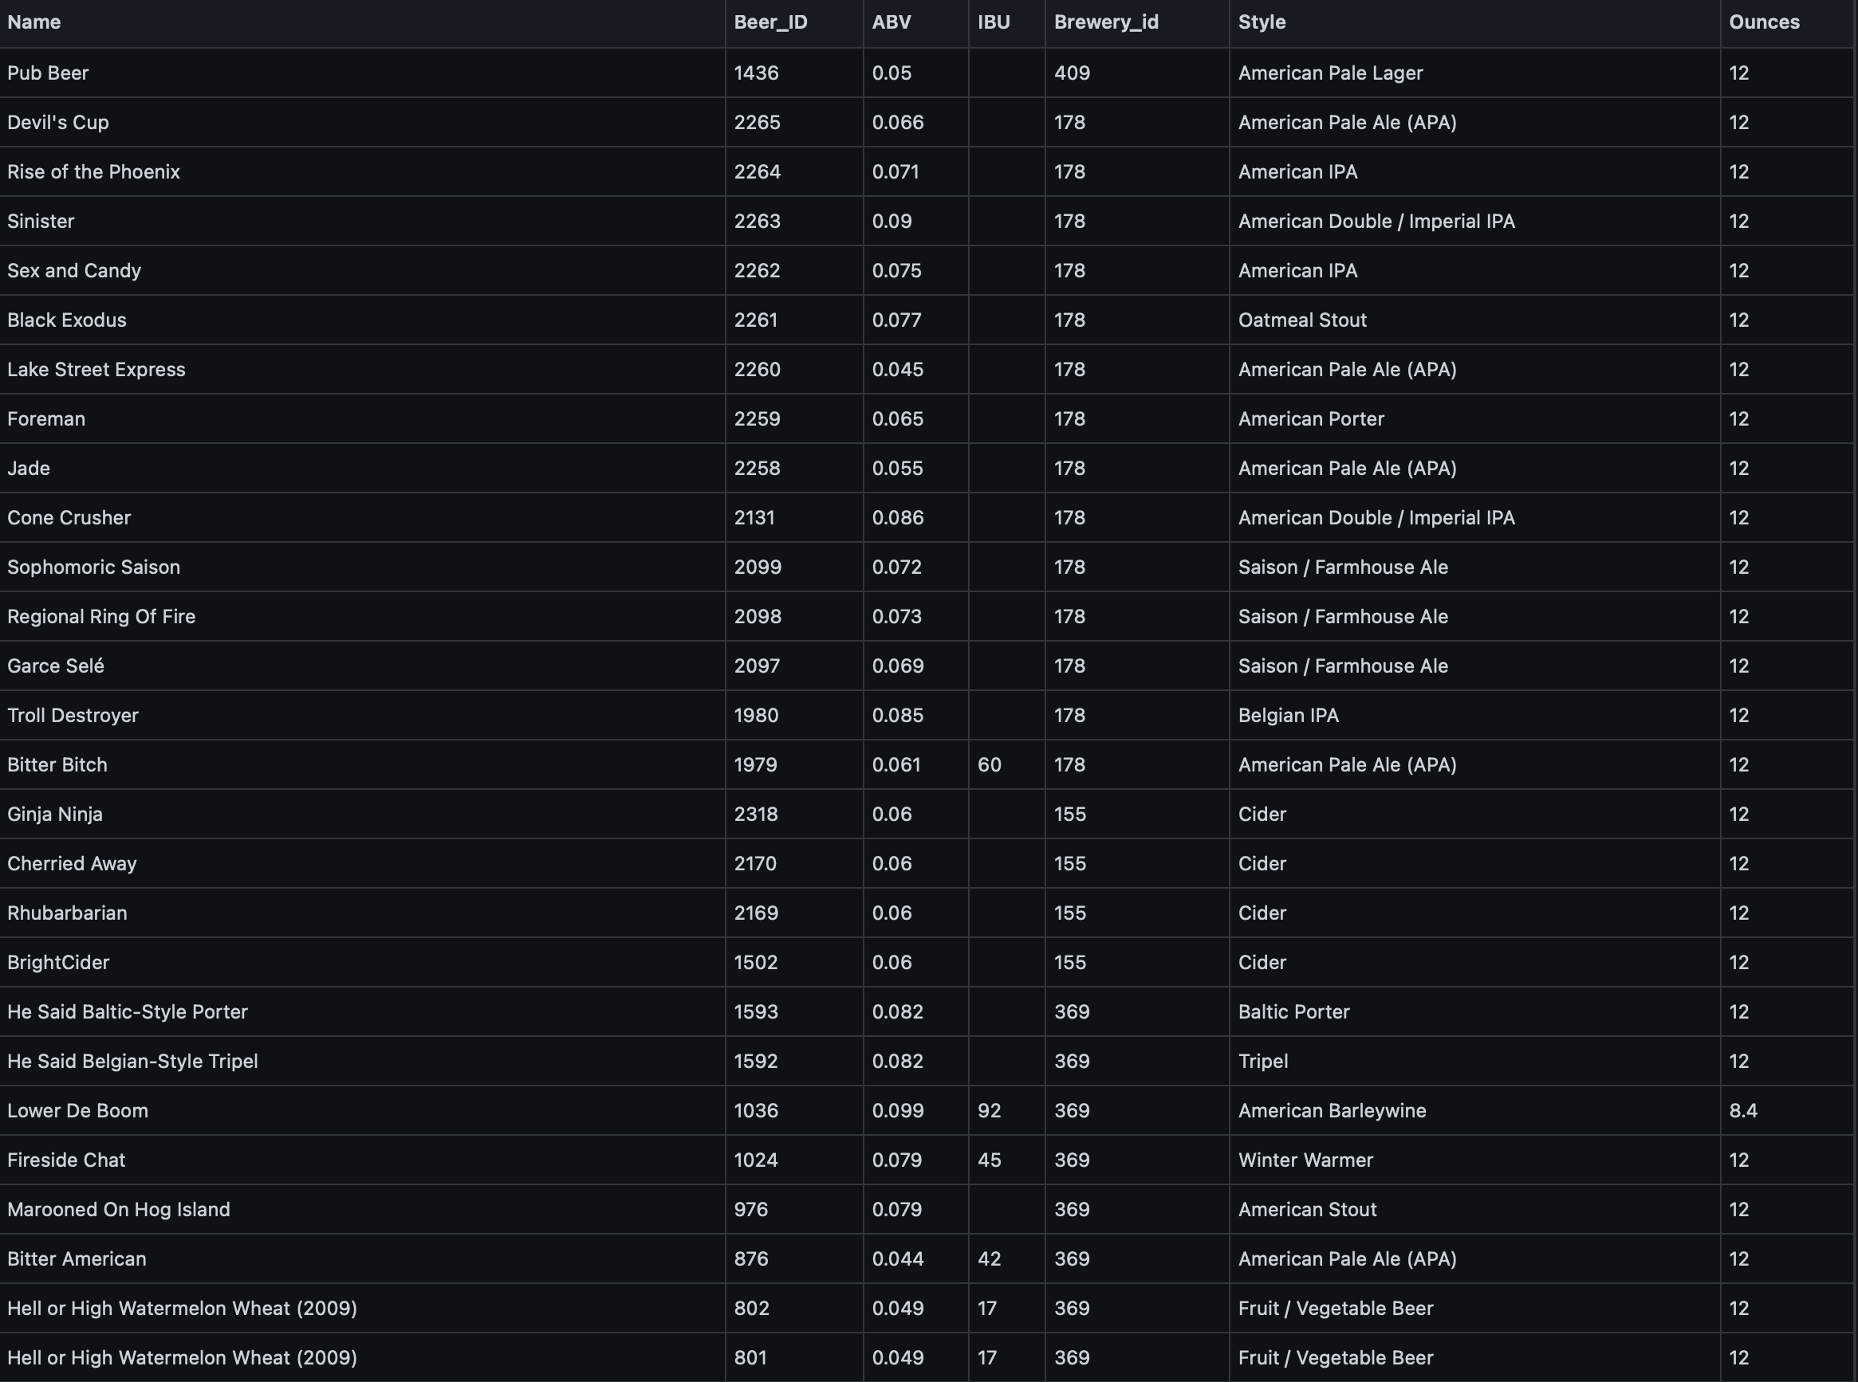
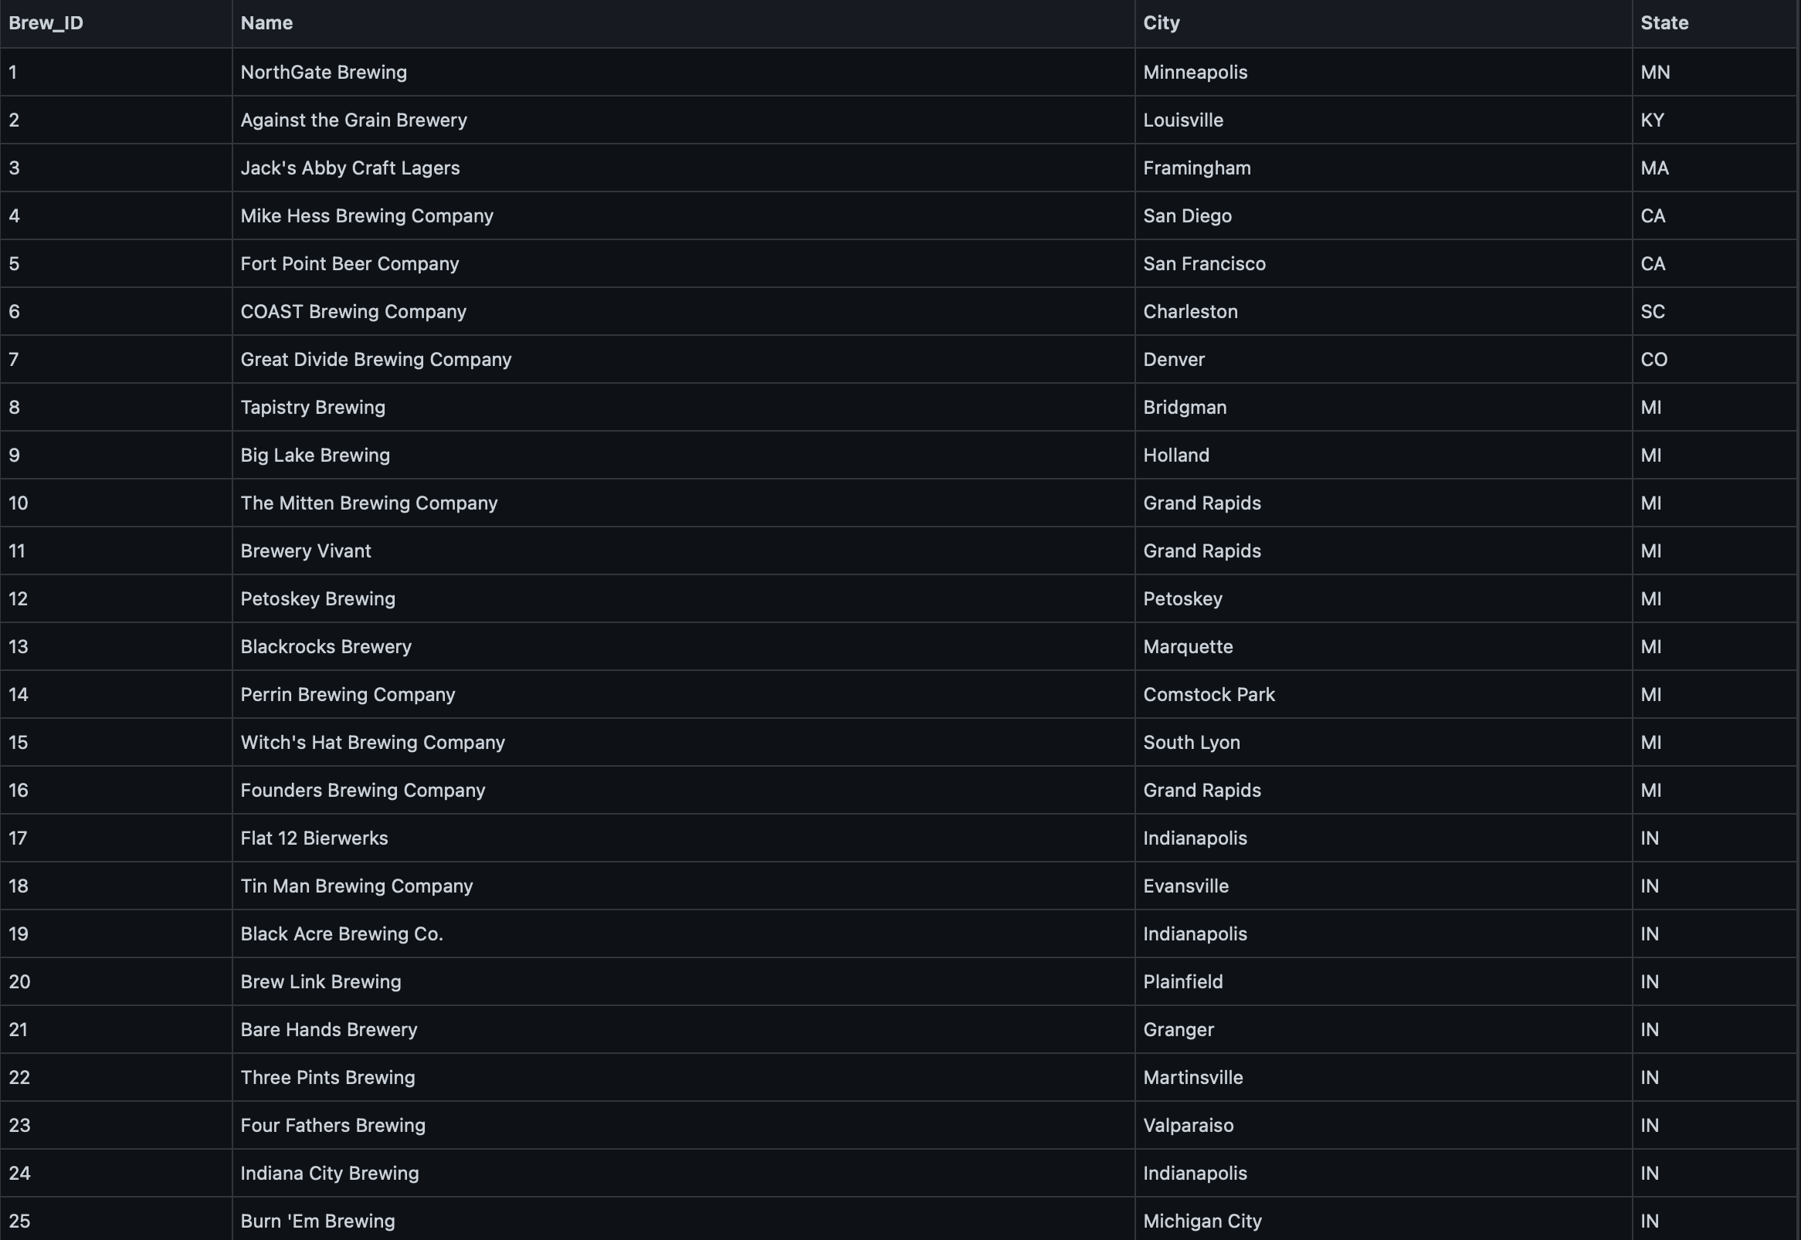
Data Sets
Beers:
Breweries:

Slide 4
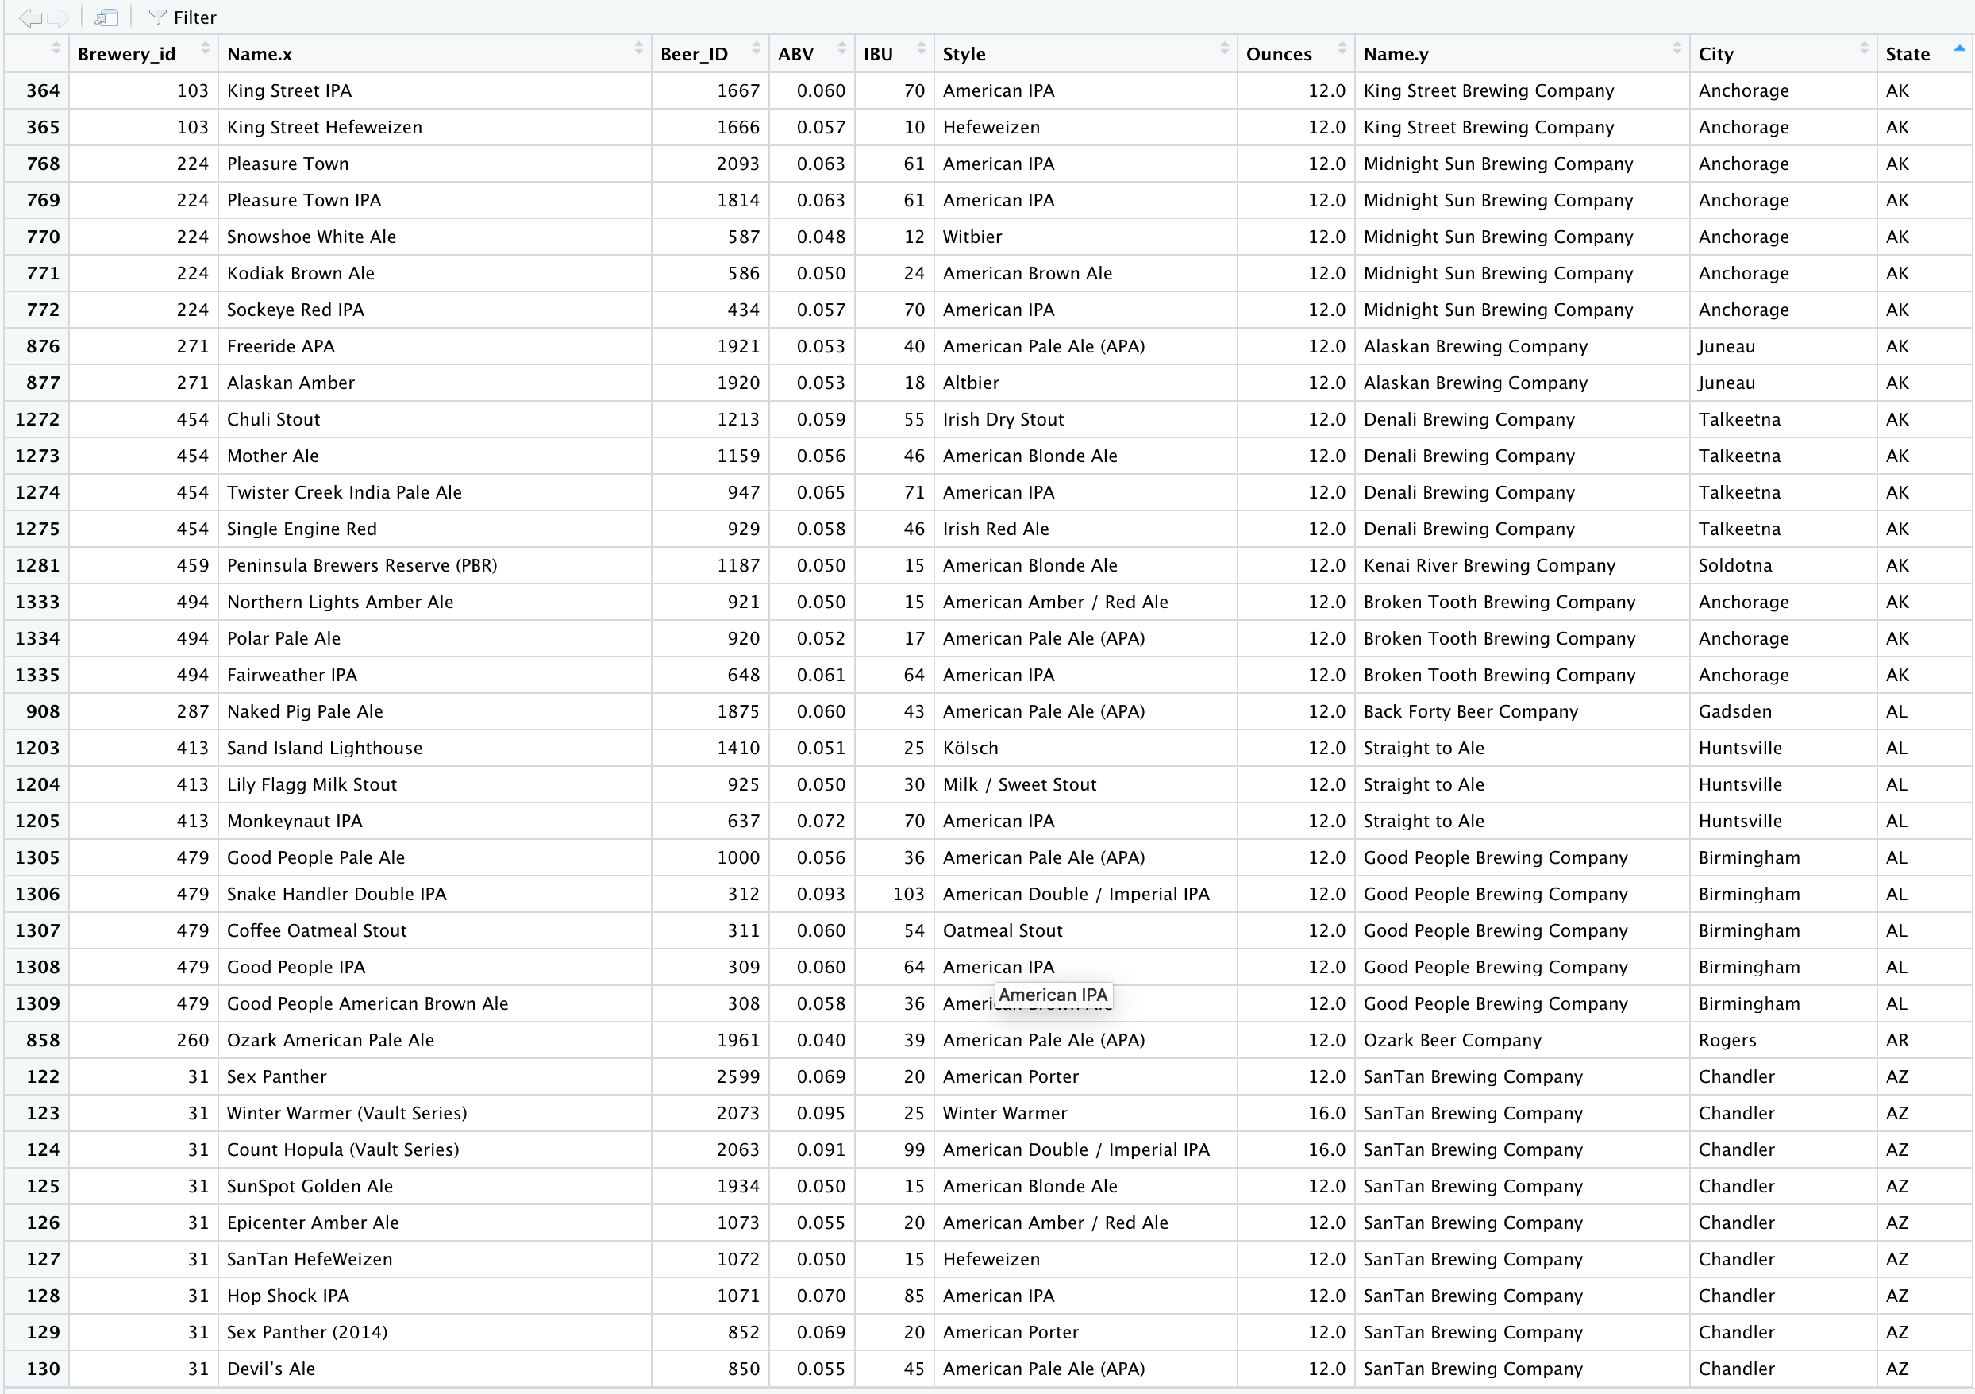
Data Sets Joined

Slide 5
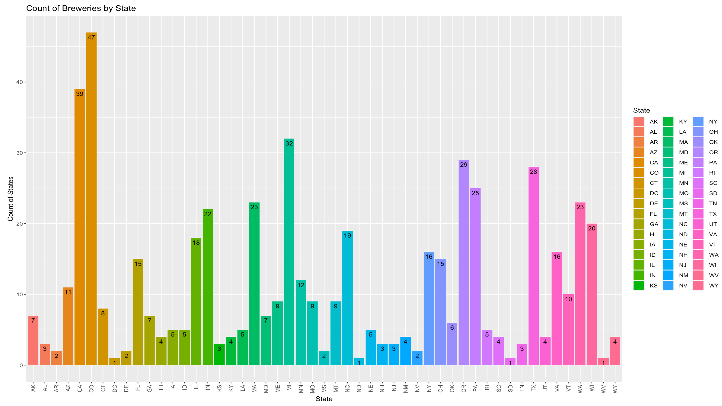
Breweries By State
Most =
CO, CA, MI
Least =
DC, ND, SD, WV

Slide 6
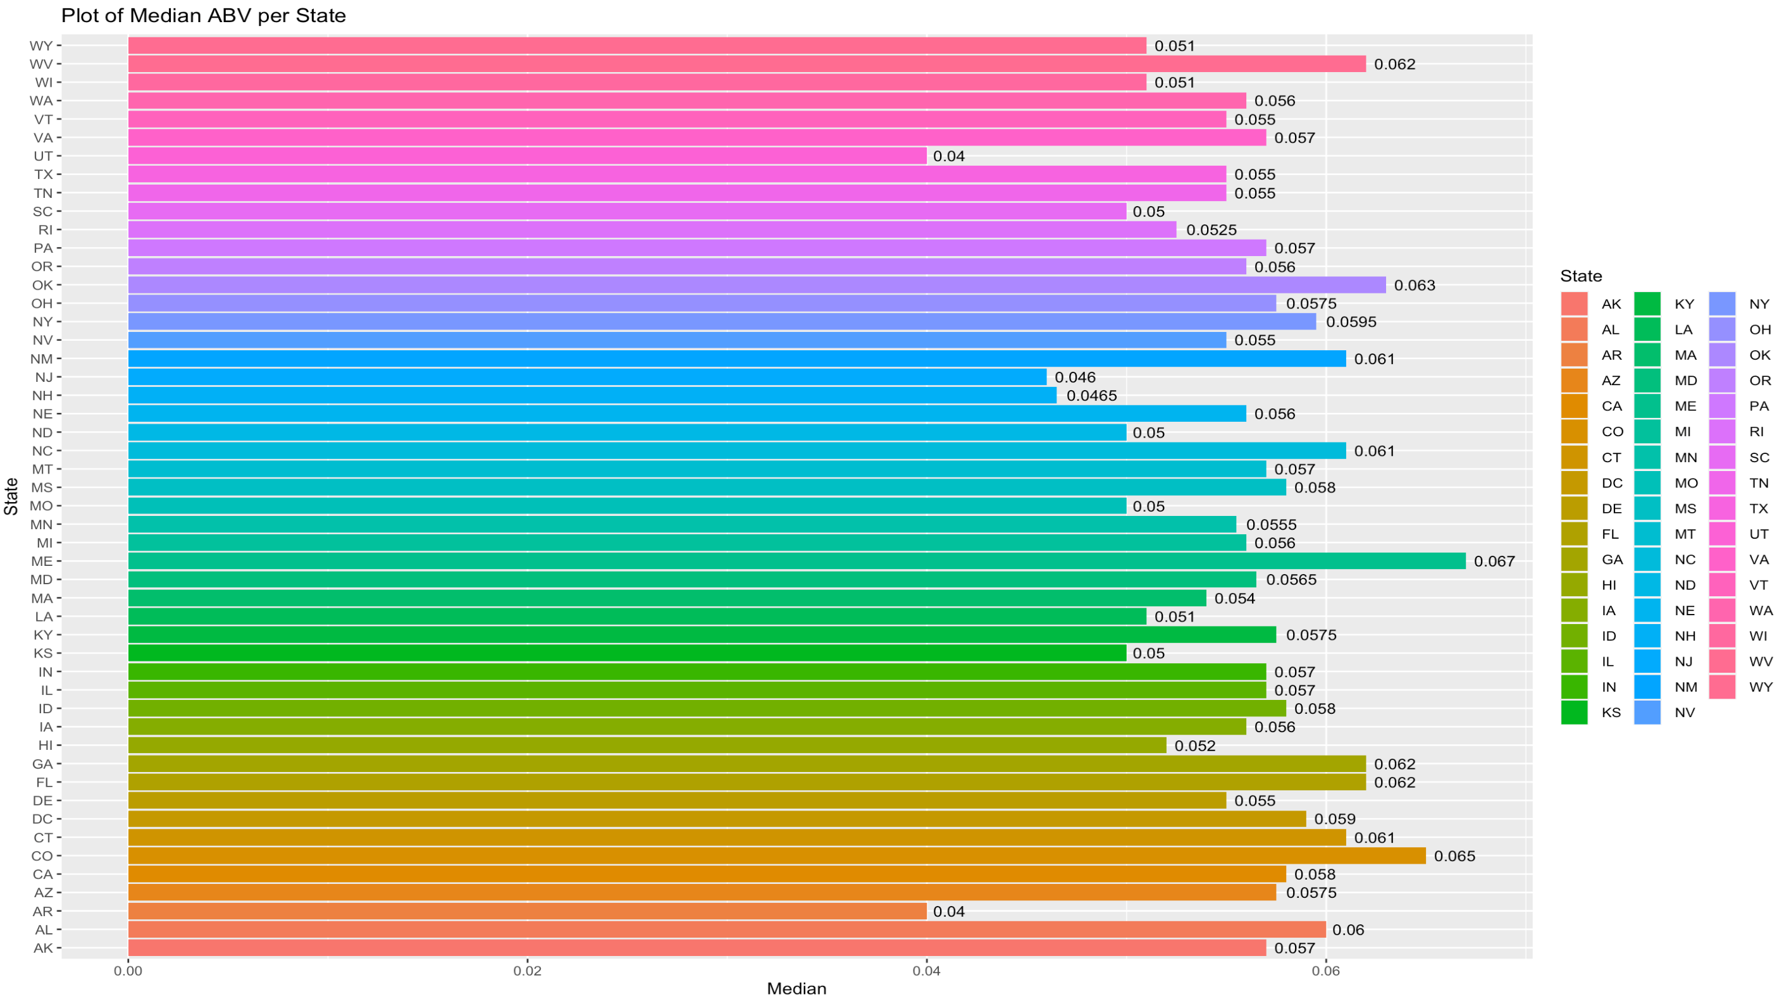
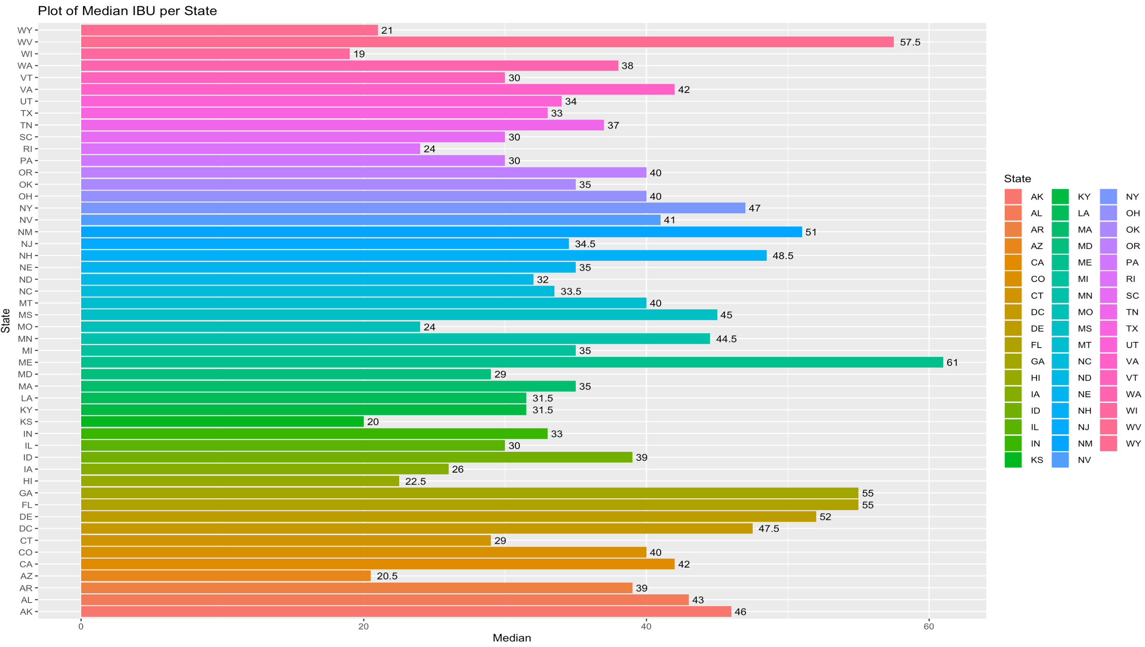
ABV & IBU By State

Slide 7
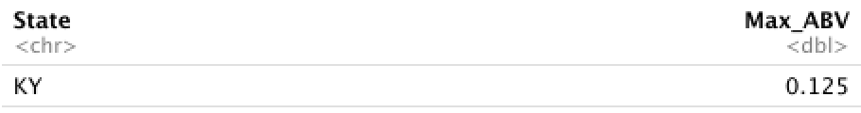
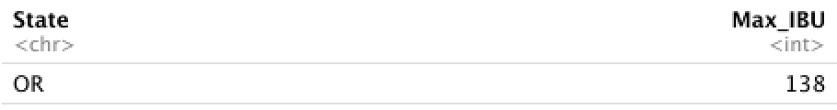
Max ABV & IBU: State
From the output observed below, we can see that the highest ABV across all states lies in Kentucky at 12.5%, and the highest IBU across all states lies in Oregon at 138 IBU.

Slide 8
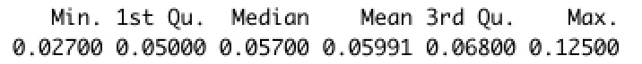
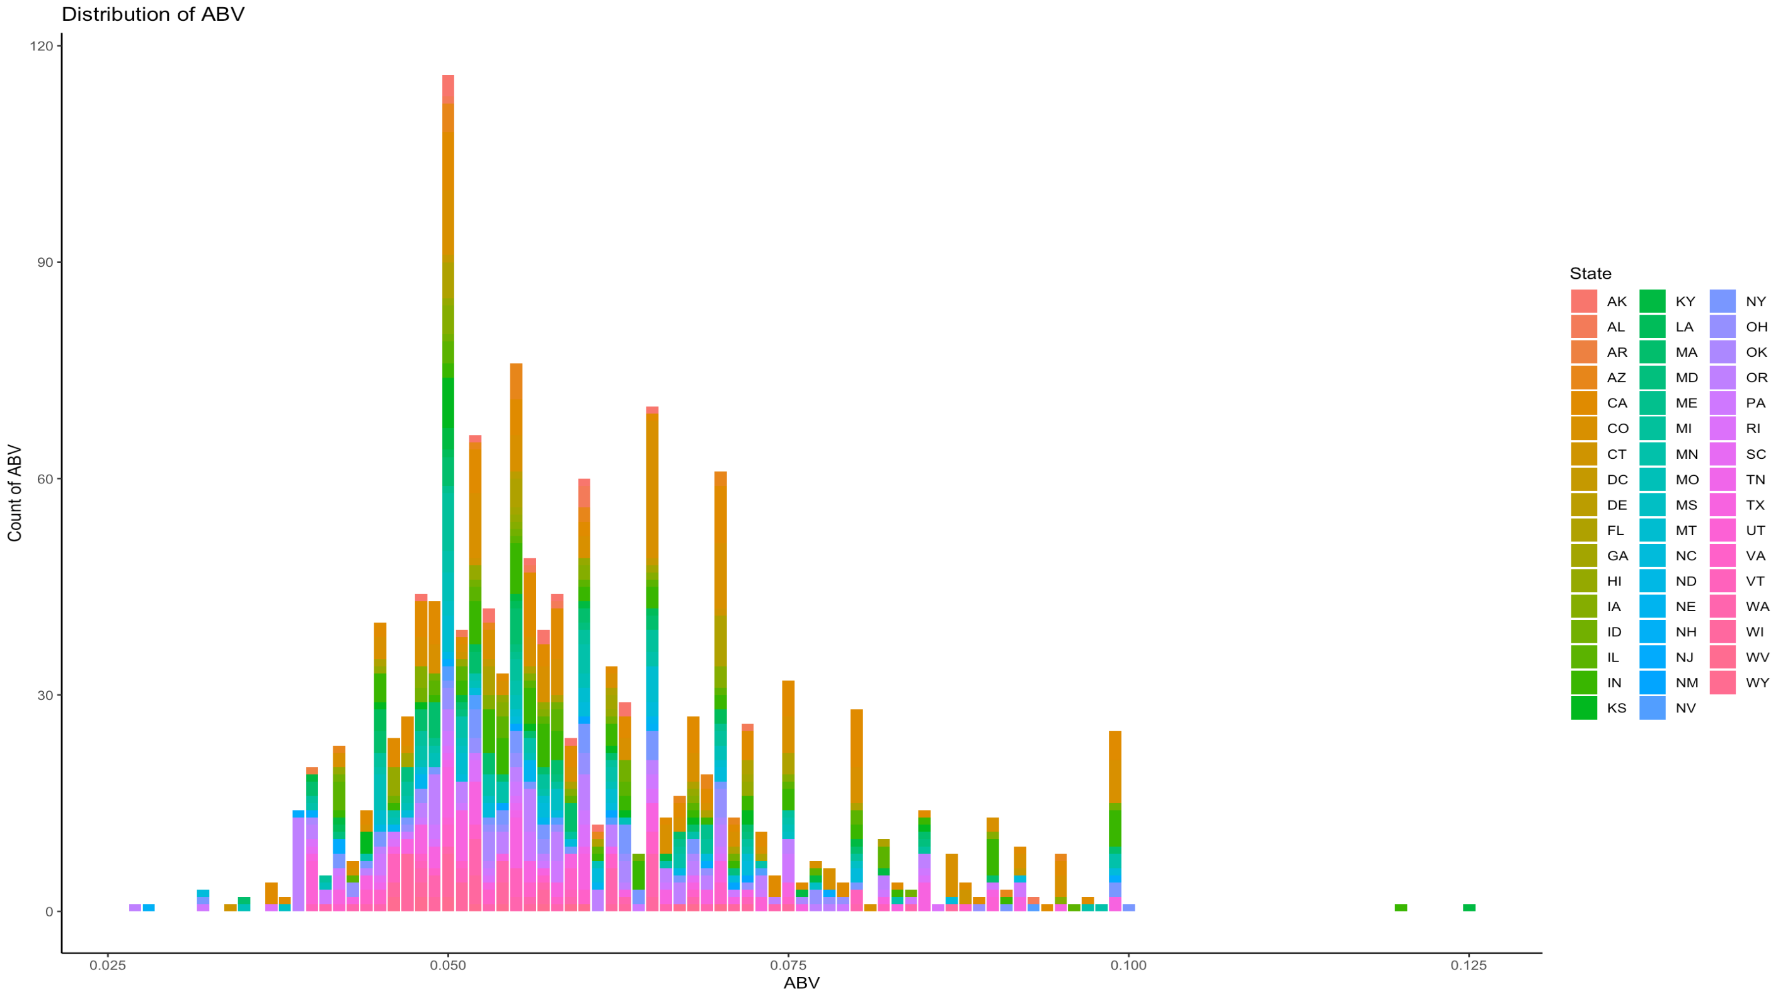
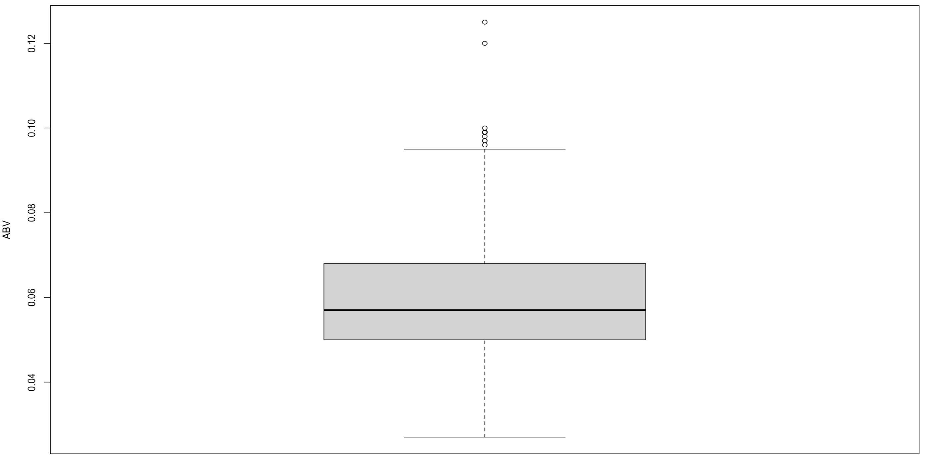
Distribution Of ABV
The plot below shows positive skewness (Skewed Right)

Slide 9
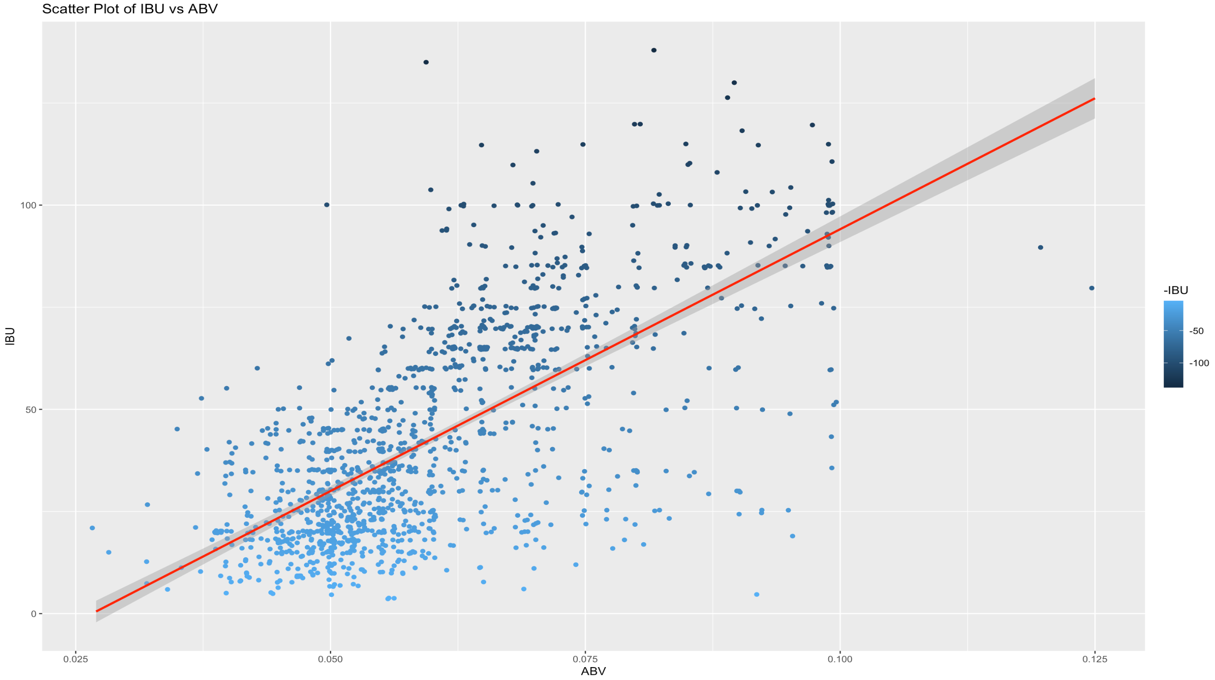
ABV & IBU Relationship
A positive correlation can be seen from the scatter plot combined with a line using the linear regression model.

Slide 10
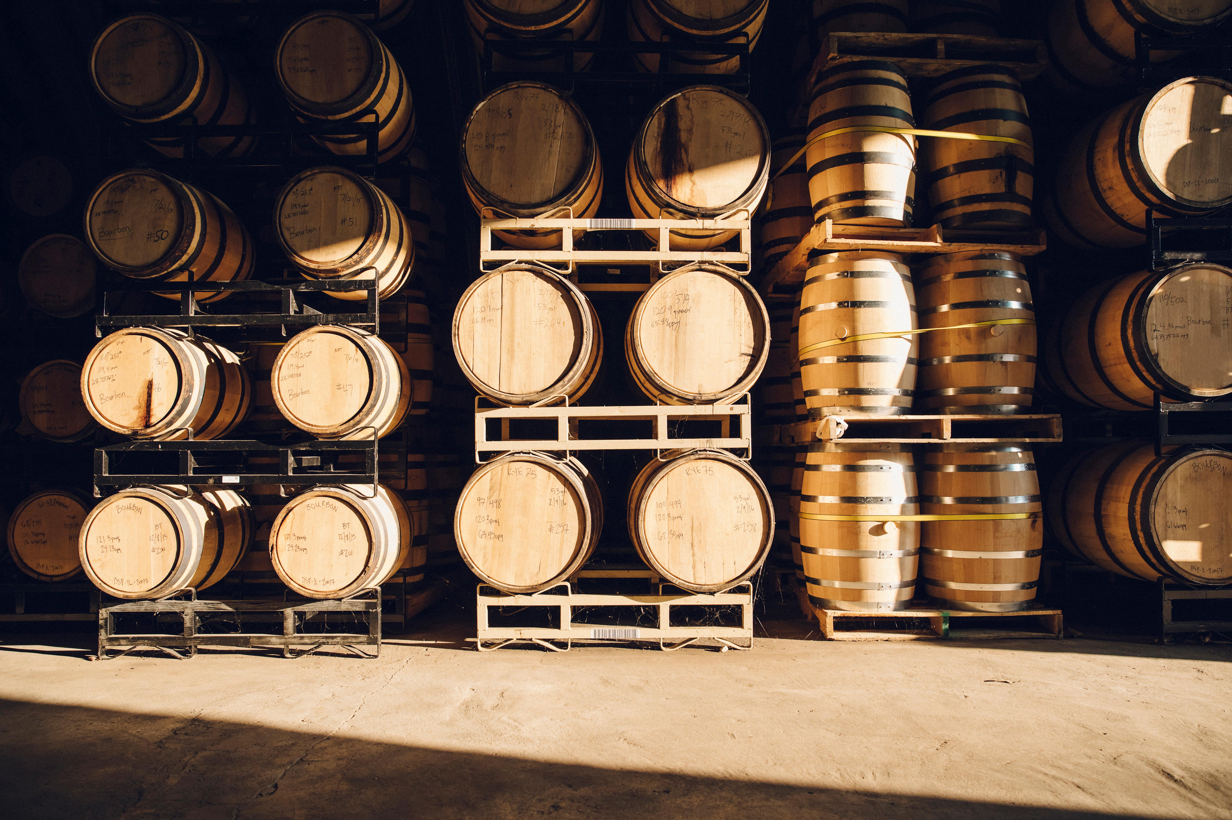
Classifying Ales vs. IPAs
KNN Classification - ABV & IBU
70-30 Train-Test Split
Accuracy of 84%
Notes:
Value - Inventory management. When a customer/client calls and creates a PO, you can reference the KNN model to see your inventory of Ales and IPAs. This will help you determine how much more/less you need to make to fulfill demand.

Slide 11

Improving Classification
Naïve Bayes Classification
ABV, IBU, City, State, and Beer Name
Improved Accuracy of 92%

Slide 12
Recommendations
Improve Inventory Management - Naïve Bayes
Increase Revenue - Selling In CO, CA, & MI
Satisfy Customer Demand - Beers With High ABV/IBU

Slide 13
Chad Kwong
ckwong@smu.edu
Notes:
This Photo by Unknown Author is licensed under CC BY-SA

Slide 14
Beers and Breweries Case Study
By Brittany Lewandowski & Chad Kwong
This Photo by Unknown Author is licensed under CC BY-SA

Slide 15
Question 1 Code
The following code uses the count() function to create a data frame of the count of Breweries per state. GGPlot2 is then used to plot the data frame as a bar plot.
Count_Of_Breweries_By_State = count(Breweries, State)
ggplot_Breweries_By_State = ggplot(data=Count_Of_Breweries_By_State, aes(x=State,y=n,fill=State)) + geom_bar(stat="identity") + theme(axis.text.x=element_text(angle = 90,vjust = 0.5, hjust = 1)) + labs(title="Count of Breweries by State",x= "State",y="Count of States") + geom_text(aes(label=n),vjust=1.6,size=3.5)
ggplot_Breweries_By_State

Slide 16
Question 3 Code
The following code uses the na.omit function to remove all NA valued rows from each default dataset
Beers <- na.omit(Beers)
Breweries <- na.omit(Breweries)

Slide 17
Question 4 Code
The code below uses the summaraise function in conjunction with the group_by function to calculate the medians. The medians are then plotted to bar plots using GGPlot2.
StateIBUMedian <- CleanData %>% group_by(State) %>% summarise(Median=median(IBU))
StateABVMedian <- CleanData %>% group_by(State) %>% summarise(Median=median(ABV))
IBUPlot = ggplot(StateIBUMedian, aes(x = State, y = Median, fill = State)) + geom_bar(stat = "identity", width = .9) + ggtitle("Plot of Median IBU per State") + geom_text(aes(label=Median),vjust=0.5, hjust=-.3 ,size=3.5) + coord_flip()
IBUPlot
ABVPlot = ggplot(StateABVMedian, aes(x = State, y = Median, fill = State)) + geom_bar(stat = "identity") + coord_flip() + ggtitle("Plot of Median ABV per State") + geom_text(aes(label=Median),vjust=0.5, hjust=-.2 ,size=3.5)
ABVPlot

Slide 18
Question 5 Code
The code below uses the summarise function combined with the group_by function to create a dataframe of all max values per state. The which.max function is then used as an index to the row with the max value overall. The final result is then displayed for both IBU and ABV
#Max IBU
StateIBU <- CleanData %>% group_by(State) %>% summarise(Max_IBU = max(IBU))
StateIBU[which.max(StateIBU$Max_IBU),]
#Max ABV
StateABV <- CleanData %>% group_by(State) %>% summarise(Max_ABV = max(ABV))
StateABV[which.max(StateABV$Max_ABV),]

Slide 19
Question 6 Code
The code below uses the summary function to list out the statistical values. We then use GGPlot2 to plot a histogram of the ABV as well as a box plot of the ABV
summary(BB_Merged$ABV)
ggplot(data=BB_Merged,aes(x=ABV,fill=State)) + geom_histogram(stat="count") + theme_classic() + labs(title="Distribution of ABV", x="ABV", y="Count of ABV")
boxplot(BB_Merged$ABV,ylab="ABV")

Slide 20
Question 7 Code
The following code uses GGplot2 to plot the IBU vs ABV as a scatterplot using the geom_point function. A line is then mapped to the scatter plot using the geom_smooth function combined with a linear regression model
ggplot(CleanData, aes(x = ABV, y = IBU, color = -IBU)) + geom_point(position = "jitter") + geom_smooth(method = lm, color = "red") + ggtitle("Scatter Plot of IBU vs ABV")

Slide 21
Question 8 Code
The following code uses KNN to classify Ale & IPA beers based on the columns IBU vs ABV.
# Setting the seed for replicability set.seed(1) # filtering the data to only display Ales and IPAs Ales <- CleanData %>% filter(grepl('Ale', CleanData$Style) | grepl("IPA", CleanData$Style)) # writting a for loop to create a new binary column for classifying each row as either an Ale or an IPA for (j in 1:length(Ales$Style)) { if (grepl("IPA", Ales$Style[j]) == TRUE) { Ales$IPA_Or_Ale[j] = "IPA" } else { Ales$IPA_Or_Ale[j] = "Ale" } } # transforming the new column into a factor Ales$IPA_Or_Ale = as.factor(Ales$IPA_Or_Ale) # Creating the test and training sets trainIndices = sample(seq(1:length(Ales$Style)),round(.7*length(Ales$Style))) trainIPA = IPA_Ales[trainIndices,] testIPA = IPA_Ales[-trainIndices,]
# Creating and running the model classifications = knn(trainIPA[,c(4,5)], testIPA[,c(4,5)], trainIPA$IPA_Or_Ale, k = 5) # Displaying the results of the model as a confusion matrix confusionMatrix(classifications, testIPA$IPA_Or_Ale)

Slide 22
Question 9 Code
The following code uses Naïve Bayes to classify Ale & IPA beers based on the columns Name, ABV, IBU, City, State.
#NB Model using Name, ABV, IBU, City, and State five_variable_model = naiveBayes(IPA_Or_Ale~., data = Ales[,c(2,4,5,9,10,11)]) five_variable_predictions = predict(five_variable_model, testIPA) Five_V_CM = confusionMatrix(five_variable_predictions, testIPA$IPA_Or_Ale) Five_V_CM

